Slide 1









My Number Interactive Notebook
$$×$$
$$\frac{1}{2}$$
$$÷$$
$$+$$
$$−$$
$$\frac{3}{5}$$
$$7$$
Name
Class
Teacher
Term 1 Semester 1
$$5^{2}$$
$$\sqrt{9}$$
1

Slide 2
Contents
Glossary or Formula Page
Page
Date
Description
2
3

Slide 3
Tasks
24
7
30
Essential Question
Questions
Notes
Summary
8
9

Slide 4
24
7
30
Date
Order of Operations
EQ – How do you solve a problem with more than one operations?
9

Slide 5

Solve
$$\left(−2\right)+5×3−(3+8)$$

Slide 6
24
7
30
Date
Order of Operations
EQ – How do you solve a problem with more than one operations?
What is the order of operations?
9

Slide 7
24
7
30
Date
Order of Operations
EQ – How do you solve a problem with more than one operations?
What is the order of operations?
Brackets
9

Slide 8
24
7
30
Date
Order of Operations
EQ – How do you solve a problem with more than one operations?
What is the order of operations?
Brackets
Multiplication and Division -
9

Slide 9
24
7
30
Date
Order of Operations
EQ – How do you solve a problem with more than one operations?
What is the order of operations?
Brackets
Multiplication and Division – from left to right
9

Slide 10
24
7
30
Date
Order of Operations
EQ – How do you solve a problem with more than one operations?
What is the order of operations?
Brackets
Multiplication and Division – from left to right
Addition and subtraction
9

Slide 11
24
7
30
Date
Order of Operations
EQ – How do you solve a problem with more than one operations?
What is the order of operations?
Brackets
Multiplication and Division – from left to right
Addition and subtraction – from left to right
9

Slide 12

24
7
30
Date
Order of Operations
EQ – How do you solve a problem with more than one operations?
What is the order of operations?
Brackets
Multiplication and Division – from left to right
Addition and subtraction – from left to right
e.g
Brackets are only there to show the 2 is negative
$$\left(−2\right)+5×3−(3+8)$$
9

Slide 13
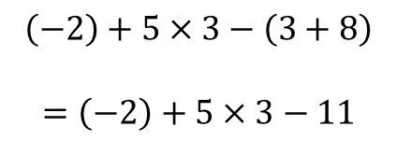
24
7
30
Date
Order of Operations
EQ – How do you solve a problem with more than one operations?
What is the order of operations?
Brackets
Multiplication and Division – from left to right
Addition and subtraction – from left to right
e.g
Brackets are only there to show the 2 is negative
Do first
$$\left(−2\right)+5×3−\left(3+8\right)$$
$$=\left(−2\right)+5×3−11$$
9

Slide 14
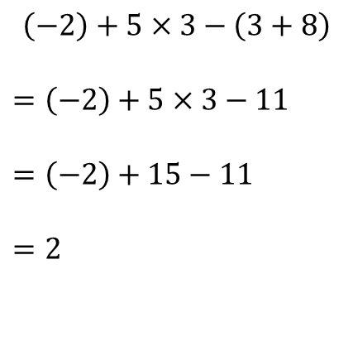
24
7
30
Date
Order of Operations
EQ – How do you solve a problem with more than one operations?
What is the order of operations?
Brackets
Multiplication and Division – from left to right
Addition and subtraction – from left to right
e.g
Brackets are only there to show the 2 is negative
$$\left(−2\right)+5×3−\left(3+8\right)$$
$$=\left(−2\right)+5×3−11$$
$$=\left(−2\right)+15−11$$
$$=2$$
Do first
Do second
Do last from left to right
9

Slide 15
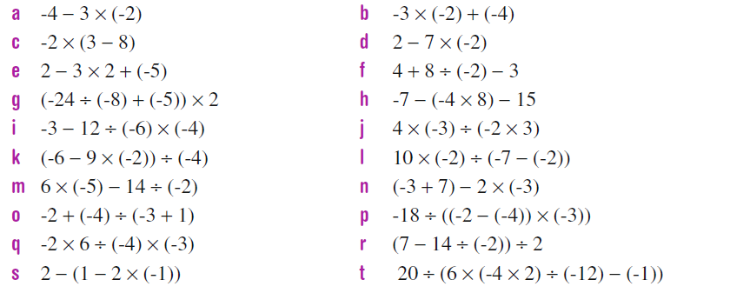
Task

Slide 16
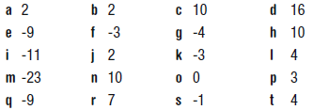
Answers

Slide 17
Notes Review
24, 7 ,30
Date
Title
Essential question
Notes complete
Notes complete with colour and diagrams
Questions completed
Contents page filed in
Formula page filled in

Slide 18
Homework
Review your notes and write a summary answering the essential question.

